Slide 1




Knowledge Discovery from Natural Language Processing & Text Mining
DAY 12: Special Data Types
15-Day Data Science Springboard
Assoc Prof Wei Liu & Tyler Bikaun, Department of Computer Science & Software Engineering, UWA wei.liu@uwa.edu.au
tyler.bikaun@research.uwa.edu.au

Slide 2


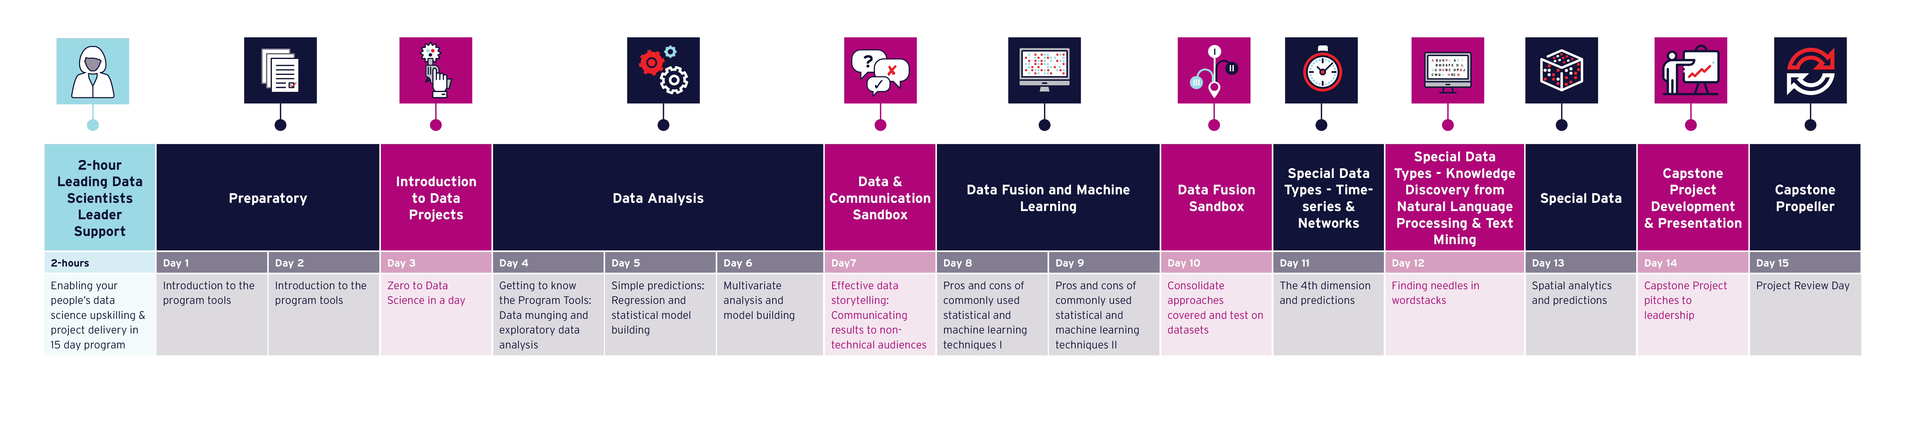
Program Timeline
DAY 12: Special Data Types – Natural Language Processing & Text Mining
© CORE Hub 2022

Slide 3
Schedule
DAY 12
AWST | AEST | Agenda
08:00 | 10:00 | Open JupyterHub, Q&A
08:15 | 10:15 | Part 1: NLP Fundamentals (5 min break ~8:45/10:45) | Tyler/Wei
09:30 | 11:30 | Morning Tea
09:45 | 11:45 | Part 2: Language Representation (5 min break ~10:30/12:30) | Tyler
11:15 | 13:15 | Lunch
12:00 | 14:00 | Part 3: Supervised NLP and Annotation (5 min break ~12:45/14:45) | Tyler
13:30 | 15:30 | Afternoon Tea
13:45 | 15:45 | Project Update | Tamryn
14:00 | 16:00 | Part 4: Unsupervised NLP (5 min break ~14:30/16:30) | Wei
15:15 | 17:15 | Q&A, Reflections, Takeaways, Menti Feedback | Tamryn
15:30 | 17:30 | Close
© CORE Hub 2022

Slide 4
A day on Natural Language Processing and Text Mining
Knowledge Representation
Machine Learning
Computational Linguistic
What is today about?
Natural Language Processing
Language Representation
Supervised Learning
Natural Language Annotation
Unsupervised Learning
Associate Prof. Wei Liu & Tyler Bikaun, UWA
Notes:
Previous text
What is today about?
- Natural language processing
- Word embeddings
- Topic modelling
- Information extraction
- Sentiment detection

Slide 5
12
Understand practical strategies and applications for using text
Provide a foundation for NLP fundamentals including text wrangling, pre-processing, and representation
Gain familiarity with supervised and unsupervised learning
Understand the natural language annotation process
Understand how to wrangle, pre-process and gain insight into text
Perform a range of supervised learning tasks
Understand the text annotation process
Perform unsupervised learning
Notes:
Previous text
Aims
1. Extract text to run ML pipelines over
2. Present the practical strategies for using text
Learning Outcomes
1. Understand how to handle text
2. Understand text pre-processing
3. Demonstrate text with supervised and unsupervised learning

Slide 6
12.0 Overview
What can we get out of natural language texts

Slide 7
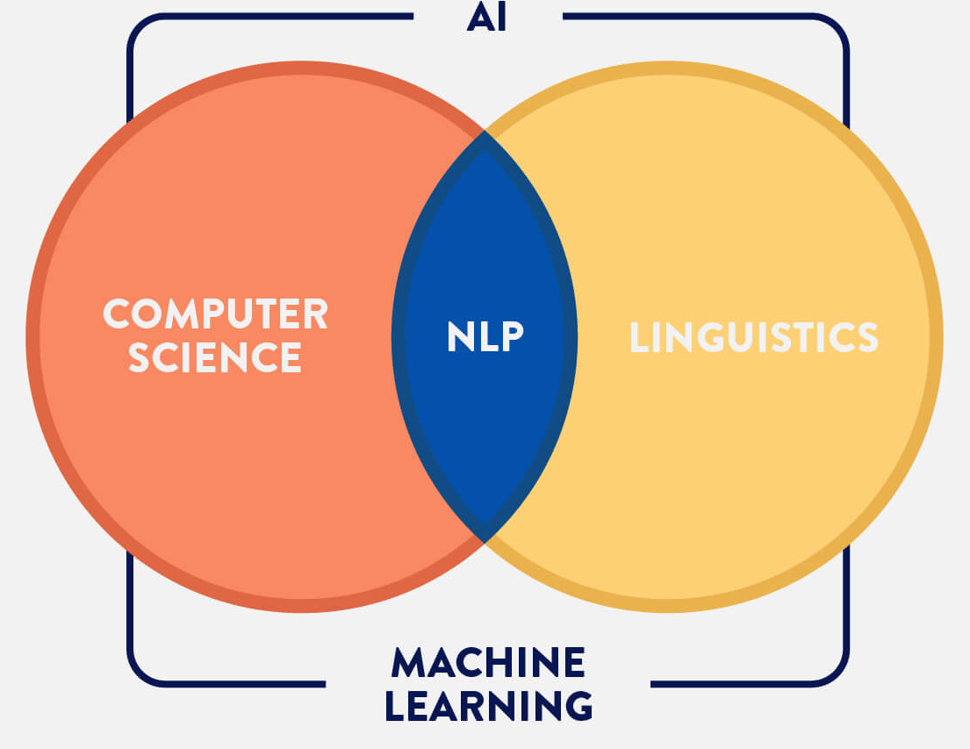
Tasks in Natural Language Processing¹
NLP Tasks
Data-to-Text Generation
Grammatical error correction
Lexical normalization
Machine translation
Named entity recognition
Question answering
Relation extraction
Sentiment Analysis
Simplification
Summarization
Text classification
…
Associate Prof. Wei Liu & Tyler Bikaun, UWA 1 - http://nlpprogress.com/
Notes:
Motivate the field of NLP through it’s wide variety of powerful applications
Classical approaches e.g. engineered pipelines vs. data-driven neural approaches (our focus here)

Slide 8
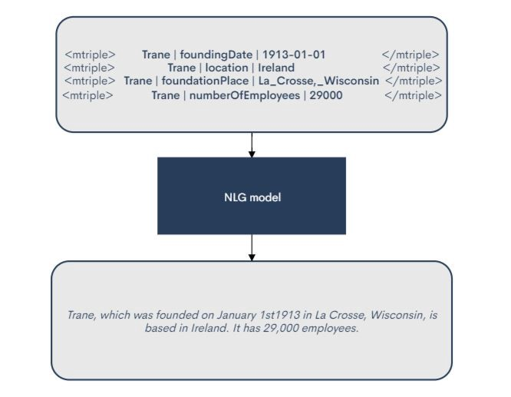
Tasks in Natural Language Processing¹
NLP Tasks
Data-to-Text Generation
Grammatical error correction
Lexical normalization
Machine translation
Named entity recognition
Question answering
Relation extraction
Sentiment Analysis
Simplification
Summarization
Text classification
…
Associate Prof. Wei Liu & Tyler Bikaun, UWA 1 - http://nlpprogress.com/
Notes:
https://miro.medium.com/max/666/1*cpwgfaZmO6SBH5nJc379Ig.jpeg

Slide 9
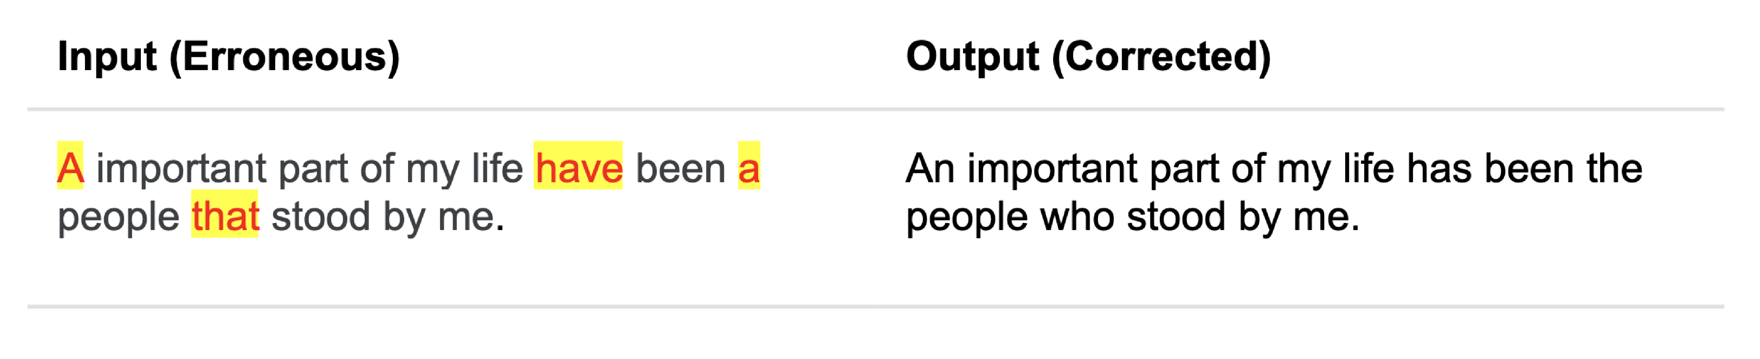
Tasks in Natural Language Processing¹
NLP Tasks
Data-to-Text Generation
Grammatical error correction
Lexical normalization
Machine translation
Named entity recognition
Question answering
Relation extraction
Sentiment Analysis
Simplification
Summarization
Text classification
…
Associate Prof. Wei Liu & Tyler Bikaun, UWA 1 - http://nlpprogress.com/
Notes:
https://www.grammarly.com/blog/engineering/adversarial-grammatical-error-correction/

Slide 10
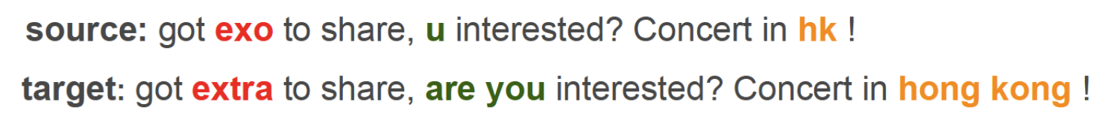
Tasks in Natural Language Processing¹
NLP Tasks
Data-to-Text Generation
Grammatical error correction
Lexical normalization
Machine translation
Named entity recognition
Question answering
Relation extraction
Sentiment Analysis
Simplification
Summarization
Text classification
…
Associate Prof. Wei Liu & Tyler Bikaun, UWA 1 - http://nlpprogress.com/
Notes:
Pic: Adapting sequence to sequence models for text normalization in social media (Lourentzou, et al. 2019)

Slide 11
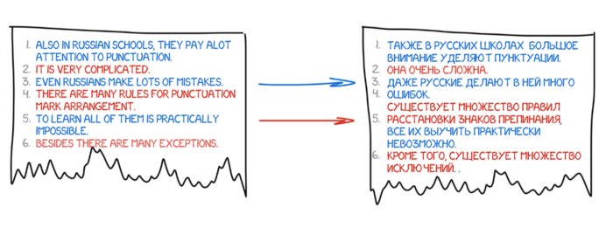
Tasks in Natural Language Processing¹
NLP Tasks
Data-to-Text Generation
Grammatical error correction
Lexical normalization
Machine translation
Named entity recognition
Question answering
Relation extraction
Sentiment Analysis
Simplification
Summarization
Text classification
…
Associate Prof. Wei Liu & Tyler Bikaun, UWA 1 - http://nlpprogress.com/
Notes:
https://cdn-media-1.freecodecamp.org/images/5qBpooShbY6xVngSotA6KINHyHP7NKeTJryb

Slide 12
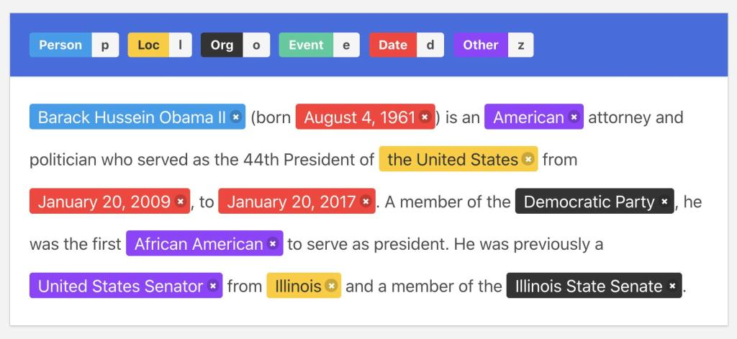
Tasks in Natural Language Processing¹
NLP Tasks
Data-to-Text Generation
Grammatical error correction
Lexical normalization
Machine translation
Named entity recognition
Question answering
Relation extraction
Sentiment Analysis
Simplification
Summarization
Text classification
…
Associate Prof. Wei Liu & Tyler Bikaun, UWA 1 - http://nlpprogress.com/
Notes:
https://editor.analyticsvidhya.com/uploads/19617Intro%20image.jpg

Slide 13
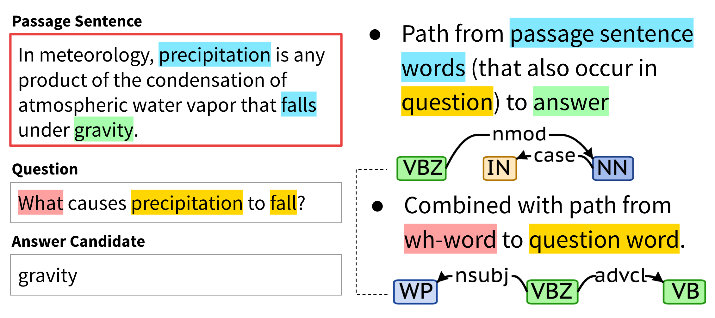
Tasks in Natural Language Processing¹
NLP Tasks
Data-to-Text Generation
Grammatical error correction
Lexical normalization
Machine translation
Named entity recognition
Question answering
Relation extraction
Sentiment Analysis
Simplification
Summarization
Text classification
…
Associate Prof. Wei Liu & Tyler Bikaun, UWA 1 - http://nlpprogress.com/

Slide 14
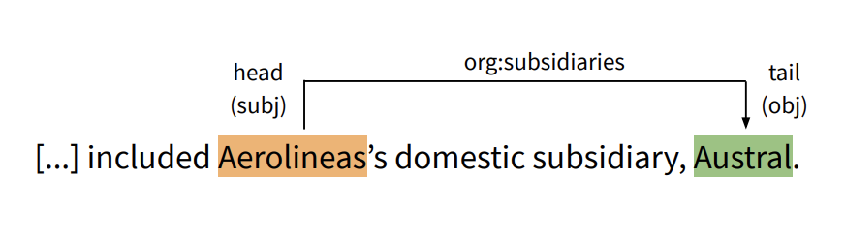
Tasks in Natural Language Processing¹
NLP Tasks
Data-to-Text Generation
Grammatical error correction
Lexical normalization
Machine translation
Named entity recognition
Question answering
Relation extraction
Sentiment Analysis
Simplification
Summarization
Text classification
…
Associate Prof. Wei Liu & Tyler Bikaun, UWA 1 - http://nlpprogress.com/

Slide 15
Tasks in Natural Language Processing¹
NLP Tasks
Data-to-Text Generation
Grammatical error correction
Lexical normalization
Machine translation
Named entity recognition
Question answering
Relation extraction
Sentiment Analysis
Simplification
Summarization
Text classification
…
Associate Prof. Wei Liu & Tyler Bikaun, UWA 1 - http://nlpprogress.com/

Slide 16
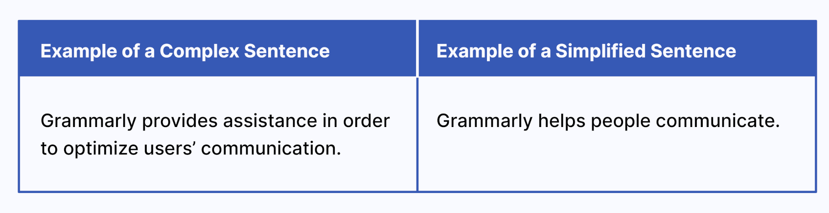
Tasks in Natural Language Processing¹
NLP Tasks
Data-to-Text Generation
Grammatical error correction
Lexical normalization
Machine translation
Named entity recognition
Question answering
Relation extraction
Sentiment Analysis
Simplification
Summarization
Text classification
…
Associate Prof. Wei Liu & Tyler Bikaun, UWA 1 - http://nlpprogress.com/

Slide 17
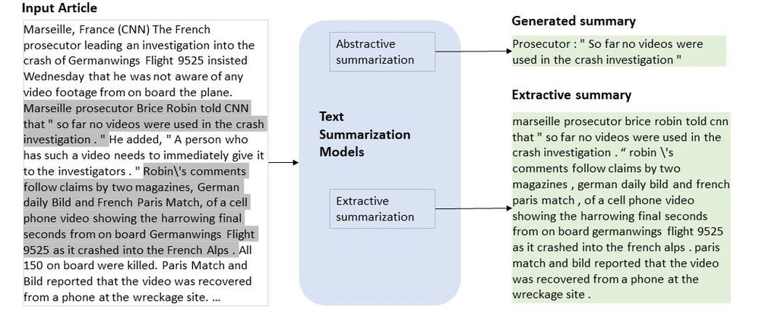
Tasks in Natural Language Processing¹
NLP Tasks
Data-to-Text Generation
Grammatical error correction
Lexical normalization
Machine translation
Named entity recognition
Question answering
Relation extraction
Sentiment Analysis
Simplification
Summarization
Text classification
…
Associate Prof. Wei Liu & Tyler Bikaun, UWA 1 - http://nlpprogress.com/

Slide 18

Tasks in Natural Language Processing¹
NLP Tasks
Data-to-Text Generation
Grammatical error correction
Lexical normalization
Machine translation
Named entity recognition
Question answering
Relation extraction
Sentiment Analysis
Simplification
Summarization
Text classification
…
Associate Prof. Wei Liu & Tyler Bikaun, UWA 1 - http://nlpprogress.com/

Slide 19
Our Work and Projects

Slide 20
Programming Language or Natural Language?
Natural Language
General
Grammatically Correct
Technical Language
Domain Specific
Large Vocabulary
Not noisy
Examples: Wikipedia
Small Vocabulary
Jargons, Misspelling
Examples: Safety logs, Maintenance work orders, geological reports
Terse
Technical language processing (TLP) aims to understand technical languages, a subset of natural languages that appears in industry-specific contexts.
Lexical Normalisation
Grammatical Error Correction
No pretrained embeddings
No ground truth
Low-resource datasets
TECHNICAL LANGUAGE PROCESSING
TEXT TO KNOWLEDGE GRARPHS
OUR TOOLS & SOLUTIONS
HUMAN-DIGITAL WORKFORCE
Notes:
We are an award wining research group UWA Natural Language and Technical Language Processing Group

Slide 21
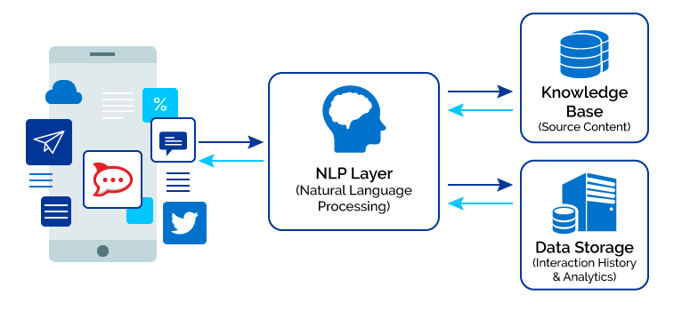
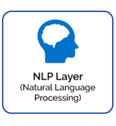

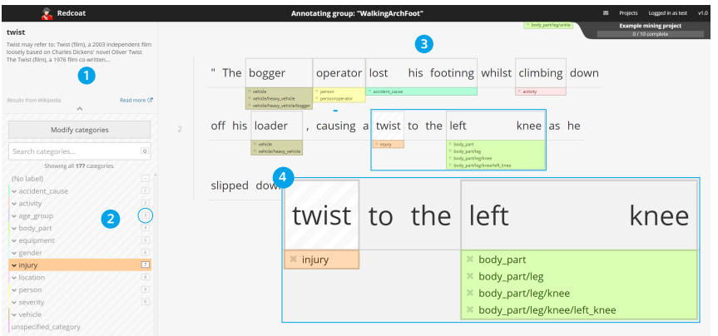
Language – Natural or Technical?
Natural Language Understanding
Information Extraction
Picture Modified From:
https://www.crayondata.com/how-do-chatbots-work-an-overview-of-the-architecture-of-a-chatbot/
TECHNICAL LANGUAGE PROCESSING
TEXT TO KNOWLEDGE GRARPHS
OUR TOOLS & SOLUTIONS
HUMAN-DIGITAL WORKFORCE
Notes:
We are an award wining research group UWA Natural Language and Technical Language Processing Group

Slide 22
What can we extract out of text? – S4
NLP for Information Extraction
Semantics
Style
Social
Sentiment
What, When, Where, How and Why?
Semantics (Entities)
Entity Recognition
Social (Relations)
Relation Extraction
Triple Extraction (Knowledge Graphs)
Style
Stylometry (fraud, authorship, forensics)
Grammar (Industry Synthetic Data Generation)
Sentiment
Social Reviews (e.g. Fraud Detection)
TECHNICAL LANGUAGE PROCESSING
TEXT TO KNOWLEDGE GRARPHS
OUR TOOLS & SOLUTIONS
HUMAN-DIGITAL WORKFORCE
Picture Credit: https://research.aimultiple.com/chatbot-architecture/
Notes:
We are an award wining research group UWA Natural Language and Technical Language Processing Group

Slide 23
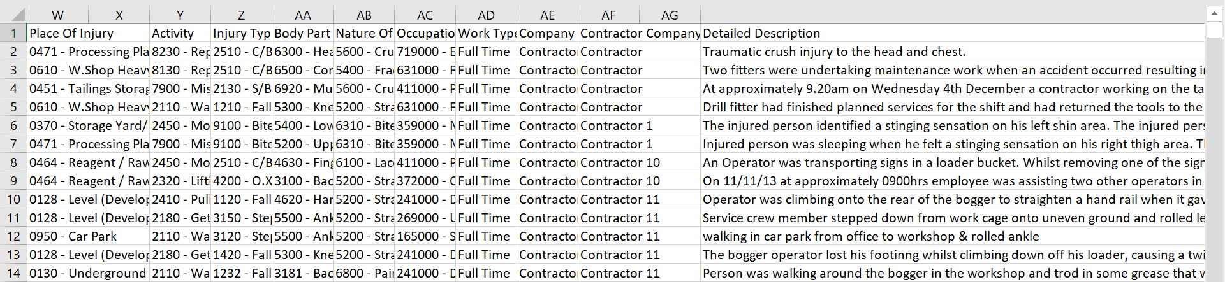

The hidden treasure in your dataset
What, When, Where, How and Why?
Individual vs. Population
Query vs. Machine Learning
location
location
activity
walking in car park from office to workshop and rolled ankle
location
injury
body part
TECHNICAL LANGUAGE PROCESSING
TEXT TO KNOWLEDGE GRARPHS
OUR TOOLS & SOLUTIONS
HUMAN-DIGITAL WORKFORCE
Notes:
We are an award wining research group UWA Natural Language and Technical Language Processing Group

Slide 24
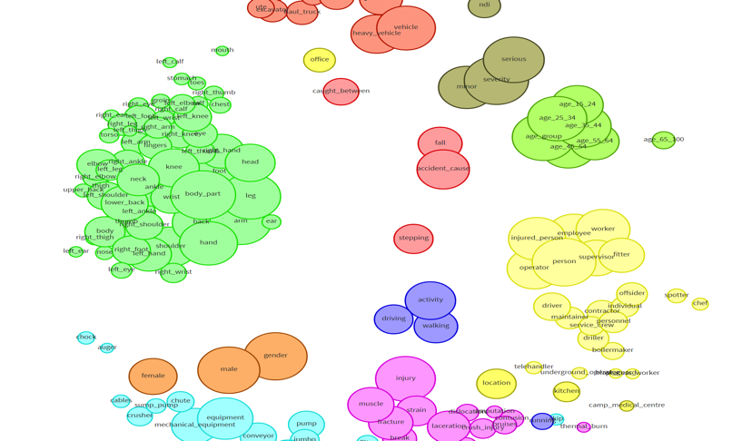
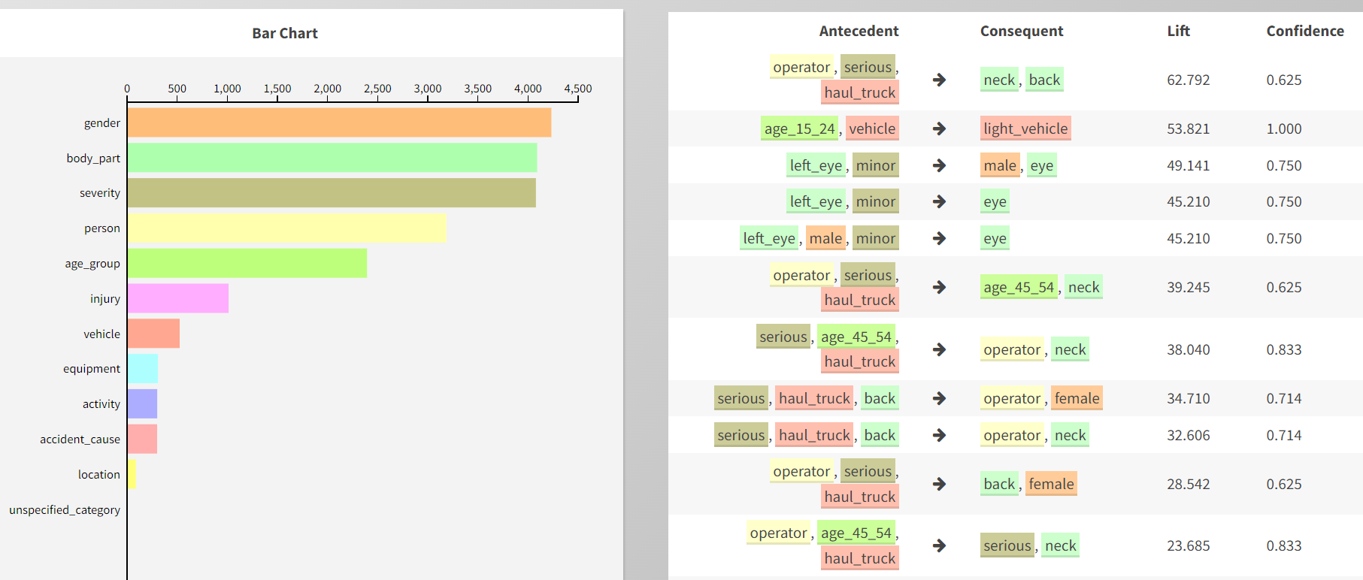
S4 – Semantics and Social
NLP for Information Extraction
Semantics
Social
activity
activity/walking
location
location/car park
location location/office
walking in car park from office to workshop and rolled ankle
location
location/workshop
injury injury/sprain
body part body part/leg
body part/leg/ankle
TECHNICAL LANGUAGE PROCESSING
TEXT TO KNOWLEDGE GRARPHS
OUR TOOLS & SOLUTIONS
HUMAN-DIGITAL WORKFORCE
Software Demo at: https://nlp-tlp.org/aquila/
Developed by Dr. Michael Stewart
Notes:
We are an award wining research group UWA Natural Language and Technical Language Processing Group

Slide 25
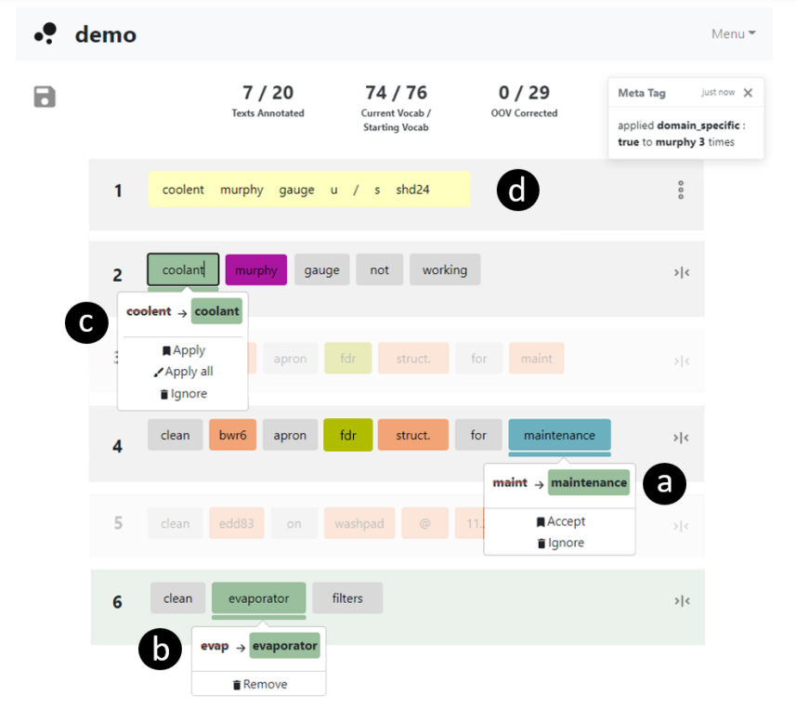
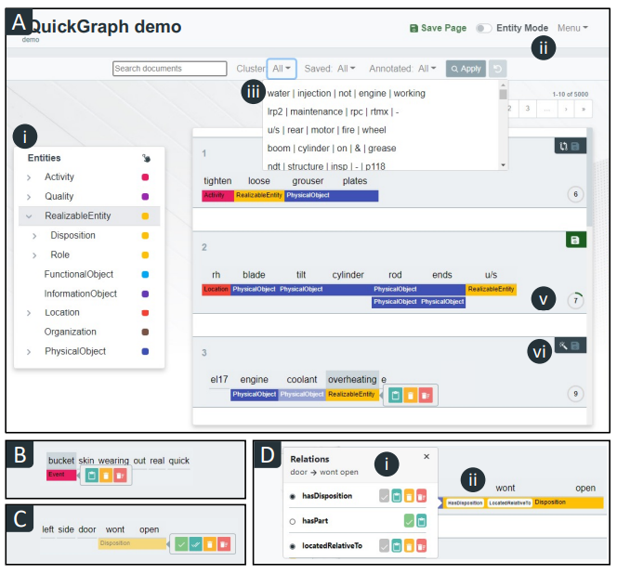
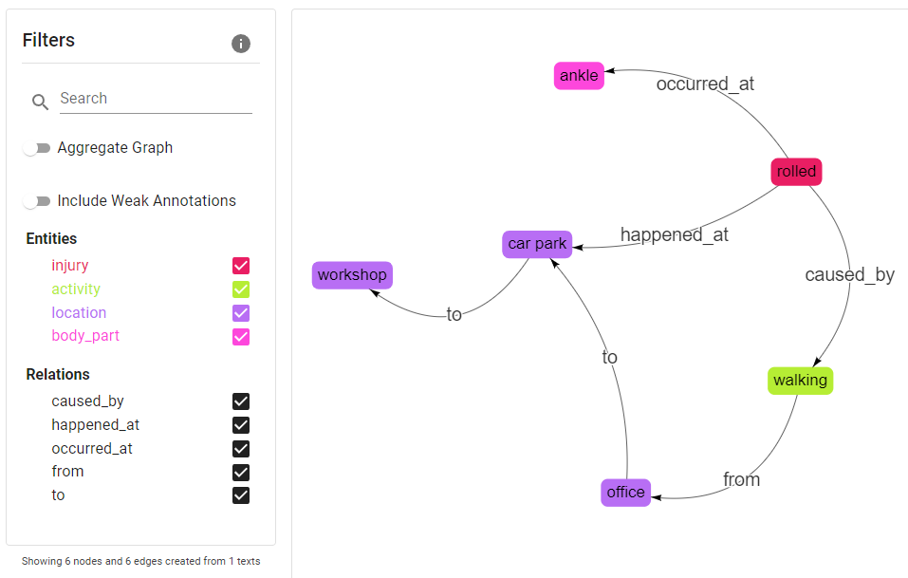
Annotation Tools Developed at UWA – QuickGraph and Lexiclean
Maintenance Work Order Processing - ARC Training Centre for Transforming Maintenance through Data Science
LexiClean
QuickGraph
TECHNICAL LANGUAGE PROCESSING
TEXT TO KNOWLEDGE GRARPHS
OUR TOOLS & SOLUTIONS
Demos Available at: https://nlp-tlp.org/
By PhD Student: Tyler Bikaun
HUMAN-DIGITAL WORKFORCE
Notes:
We are an award wining research group UWA Natural Language and Technical Language Processing Group

Slide 26
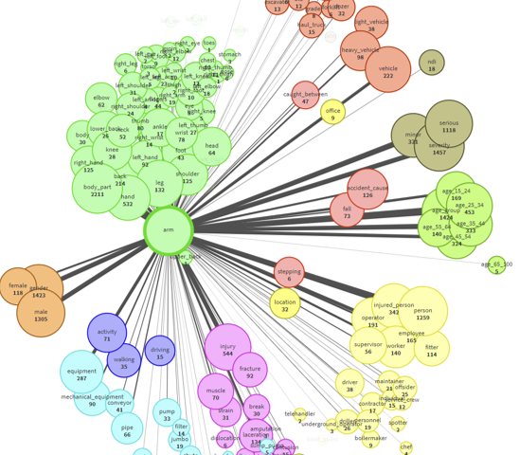

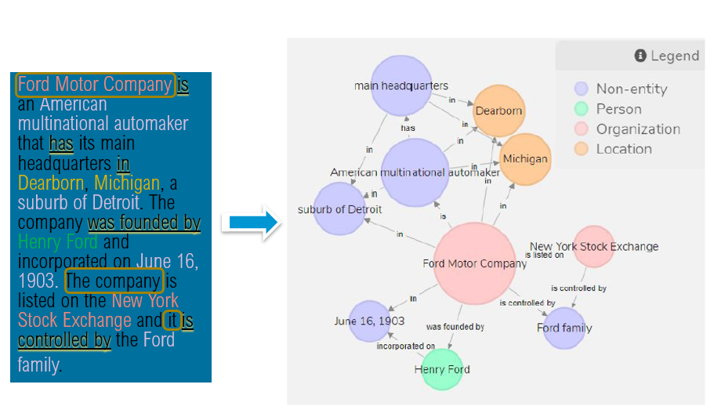
Award Winning NLP & KG Solutions
WAITTA INCITE Award Finalist 2022
_{WAITTA INCITE Award 2019}
_{ICDM Knowledge Graph Contest 1}^{st} _{Prize}
UWA Natural Language and Technical Language Processing Group
https://nlp-tlp.org
TECHNICAL LANGUAGE PROCESSING
TEXT TO KNOWLEDGE GRARPHS
OUR TOOLS & SOLUTIONS
HUMAN-DIGITAL WORKFORCE
Notes:
We are an award wining research group UWA Natural Language and Technical Language Processing Group

Slide 27
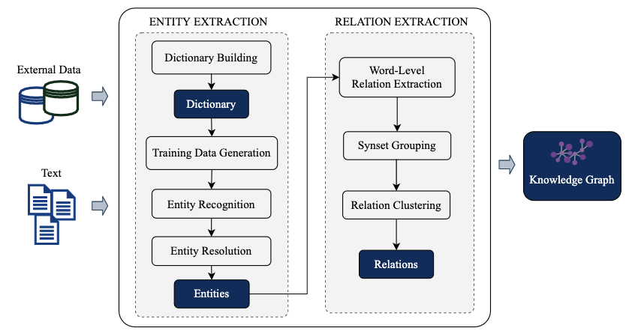
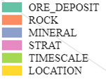
PhD Thesis of
Majigsuren Enkhsaikhan
KG Extraction from Geological Surveys
Supported by
GSWA
Knowledge Graph Schema
Enkhsaikhan et al. (2021), “Understanding Mineral Depositional Conditions using Machine Reading of Text”, Ore Geology Reviews
Enkhsaikhan et al. (2020), “Auto-Labelling Entities in Low Resource Text: A Geological Case Study”, Knowledge and Information Systems
Enkhsaikhan et al. (2018), “Towards geological knowledge discovery using vector-based semantic similarity”, Proceedings of the 14th Int. Conf. on Advanced Data Mining and Applications
TECHNICAL LANGUAGE PROCESSING
TEXT TO KNOWLEDGE GRARPHS
OUR TOOLS & SOLUTIONS
HUMAN-DIGITAL WORKFORCE
Notes:
We are an award wining research group UWA Natural Language and Technical Language Processing Group

Slide 28
TLP – redefining the workforce
Natural Language Understanding
Information Extraction
Picture Modified From:
https://www.crayondata.com/how-do-chatbots-work-an-overview-of-the-architecture-of-a-chatbot/
TECHNICAL LANGUAGE PROCESSING
TEXT TO KNOWLEDGE GRARPHS
OUR TOOLS & SOLUTIONS
HUMAN-DIGITAL WORKFORCE
Notes:
We are an award wining research group UWA Natural Language and Technical Language Processing Group

Slide 29



Human – Digital Workforce: Trends in Automation 2022
People will work side-by-side with virtual robotic assistants—sharing tasks, passing work back and forth, collaborating.
Within the next 5 years, hybrid human-digital workforces will
Work in a task-oriented (rather than software application-oriented) manner, and
Be part of virtual assembly line
TECHNICAL LANGUAGE PROCESSING
TEXT TO KNOWLEDGE GRARPHS
OUR TOOLS & SOLUTIONS
HUMAN-DIGITAL WORKFORCE
Notes:
We are an award wining research group UWA Natural Language and Technical Language Processing Group

Slide 30
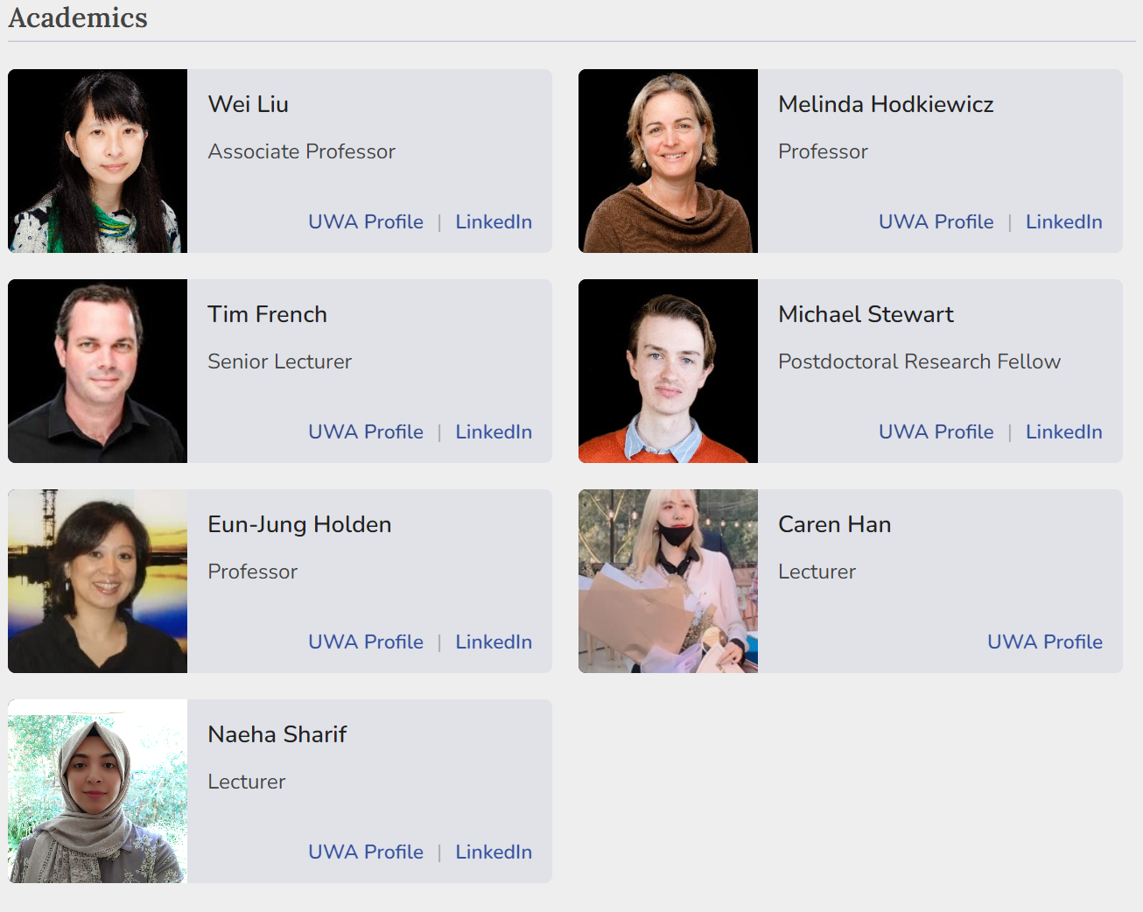
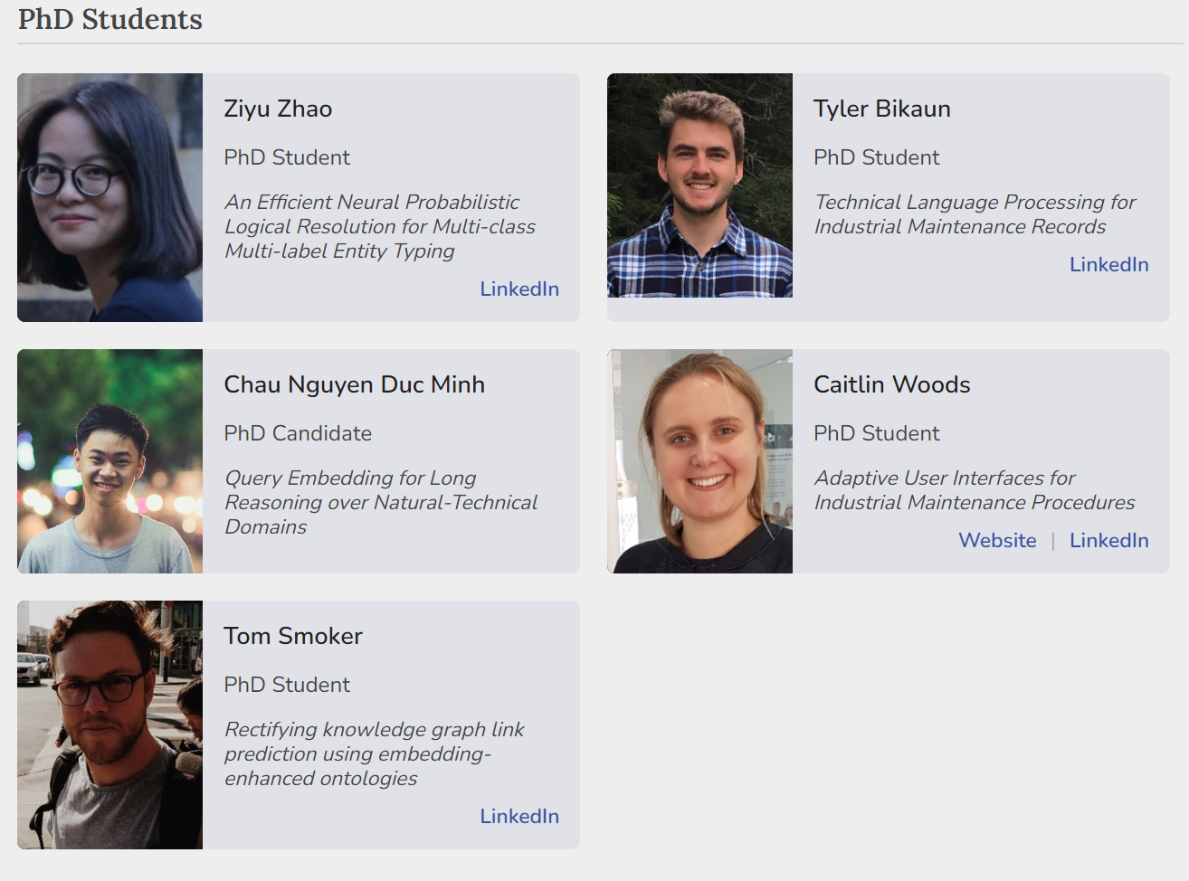



NLP-TLP Group: https://nlp-tlp.org/
THANK YOU
AI 2022: https://ajcai2022.org/
wei.liu@uwa.edu.au
linkedin.com/in/wei-liu-b0b4521ab
Notes:
We are an award wining research group UWA Natural Language and Technical Language Processing Group

Slide 31
12.1 Fundamentals of NLP
Text wrangling, pre-processing and analysis
Notes:
Handling –
Processing –
Representation -

Slide 32
Fundamentals of Natural Language Processing
Agenda (Hands-on Session) - An introduction to the Natural Language Tool Kit (NLTK)
Tokenization
Stop-words
Feature distributions
N-grams
Stemming
Concordancing
Dispersion plotting
Bi-gram significance
Word contexts
Word similarities
Parts-of-Speech (POS)
Named entity recognition
Associate Prof. Wei Liu & Tyler Bikaun, UWA Notebook: 12.1 – An Introduction to the NLTK

Slide 33
12.2 Fundamentals of NLP
Representing natural language

Slide 34
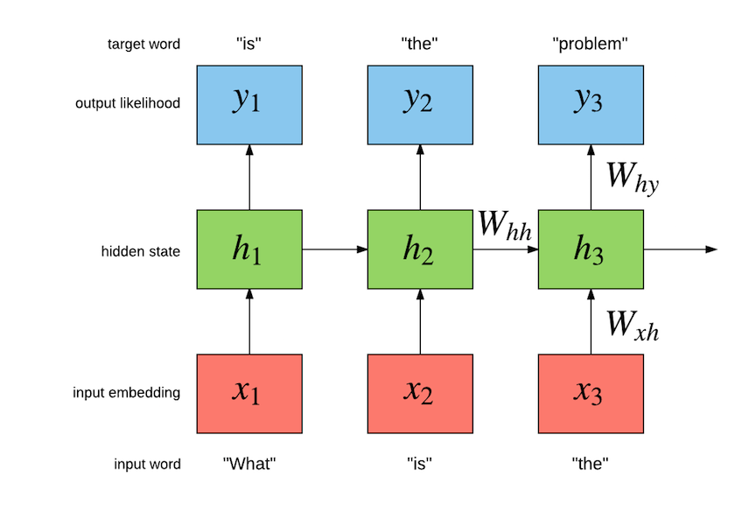
Word Embeddings: One-hot Vectors
Word representations – one-hot vectors
What is the name of the prime minister of Australia?
What | = | [10000000]
is | = | [01000000]
the | = | [00100000]
name | = | [00010000]
of | = | [00001000]
the | = | [00100000]
prime | = | [00000100]
minister | = | [00000010]
of | = | [00001000]
Australia | = | [00000001]
(Socher, 2018)
Associate Prof. Wei Liu & Tyler Bikaun, UWA
Notes:
How do we represent words?
One hot encoding (count vectorising); basic, naïve.
Vector dimension becomes as large as the number of words in the vocabulary. This is not ideal for large ML systems. Orthogonality
Socher, R. (2018, January 18). Natural Language Processing with Deep Learning CS224N/Ling284 [PowerPoint slides]. https://web.stanford.edu/class/archive/cs/cs224n/cs224n.1184/lectures/lecture2.pdf

Slide 35
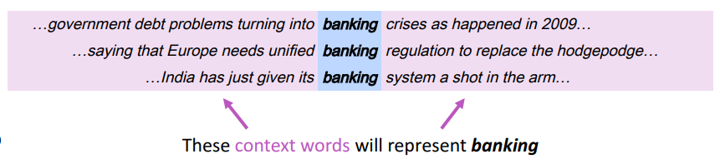
Word Embeddings: Learning Context
Representing words by their context
You shall know a word by the company it keeps
J. R. Firth 1957
prime | = | [0,0,0,0,0,1,0,0]
minister | = | [0,0,0,0,0,0,1,0]
prime | = | [-0.1, 0.1, 0.2, 0.3, 0.3, 0.4, 0.1, 0.7]
minister | = | [-0.2, 0.2, 0.4, 0.2, 0.2, 0.2, 0.1, 0.6]
One-hot
Embeddings
Associate Prof. Wei Liu & Tyler Bikaun, UWA
Notes:
How do we capture semantic and syntactic similarities, relationships with other words, etc.
Concordance
“You shall know a word by the company it keeps” (J. R. Firth 1957: 11)
Distribution representations of words; that is, we want to introduce dependence between words. We are unable to determine similarity between one hot vectors because they’re orthogonal e.g. their dot product is zero.
Socher, R. (2018, January 18). Natural Language Processing with Deep Learning CS224N/Ling284 [PowerPoint slides]. https://web.stanford.edu/class/archive/cs/cs224n/cs224n.1184/lectures/lecture2.pdf

Slide 36
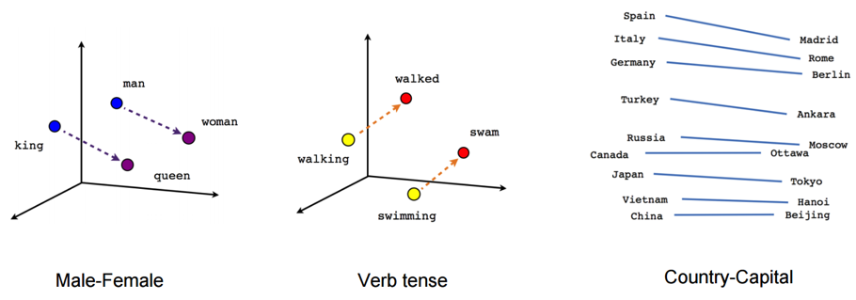
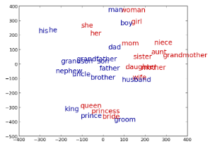
Word Embeddings: Power of Embeddings
Imagine doing simple math with words
“A is to B as C is to D” tasks
-word_{A} – word_{B} – word_{C} ≅ word
Associate Prof. Wei Liu & Tyler Bikaun, UWA
http://rare-technologies.com/word2vec-tutorial/
Notes:
Word analogies. For example: King – Man + Queen = Female
Similarity -> distance; relationship between words -> angle (the same relationship has the same angle).
Non-orthogonal vectors allows us to take advantage of these representations unlike one-hot vectors which are orthogonal e.g. 90 degrees apart

Slide 37
Word Embeddings: Analogy Task Examples
“A is to B as C is to D” tasks
groom bride husband wife groom bride king queen groom bride man woman groom bride nephew niece groom bride policeman policewoman groom bride prince princess | Athens Greece Baghdad Iraq Athens Greece Bangkok Thailand Athens Greece Beijing China Athens Greece Berlin Germany Athens Greece Bern Switzerland | short shorter small smaller short shorter smart smarter short shorter strong stronger short shorter tall taller short shorter tight tighter short shorter tough tougher short shorter warm warmer short shorter weak weaker short shorter wide wider short shorter young younger short shorter bad worse
Associate Prof. Wei Liu & Tyler Bikaun, UWA
Notes:
20,000 syntactic and semantic test examples (Google)
The top 30,000 words ranked according to frequency are used for the evaluation shown.

Slide 38
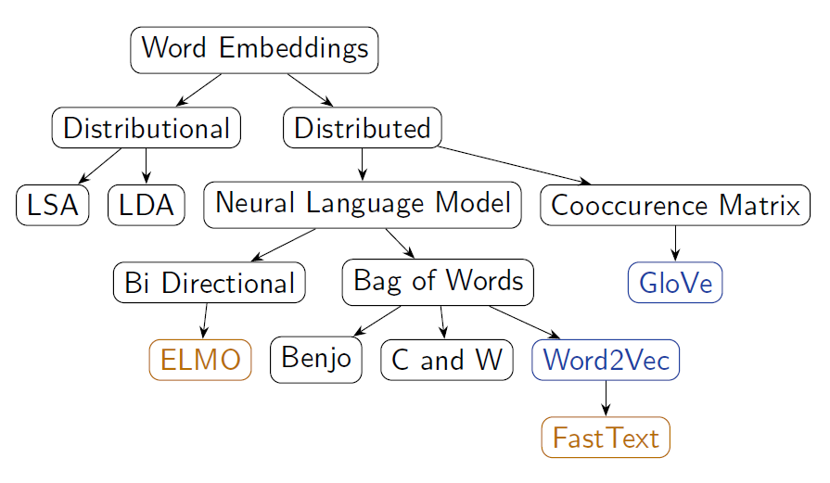
Word Embeddings: Techniques
Many ways of obtaining word vectors
New techniques are being developed every year!
Associate Prof. Wei Liu & Tyler Bikaun, UWA
Notes:
Word2Vec (neural embedding model); ‘self-supervised’
1. one-word context (predicting one word given only one word); referred to as a continuous bag of words (CBOW) model. Input is a onehot encoded vector
2. multi-word context (similar to one-word but we need in multiple words)
3. Skip-gram model (opposite to CBOW multi-word). Given word w predict n words surrounding it (windowing).
GloVe (Global Vectors for Word Representation)-> captures the meaning of a word embedding with the structure of the entire observed corpus. This model utilises word frequencies and co-occurrence counts in a unsupervised manner.
ELMO (Embeddings from Language Models)-> Context-dependent embeddings; uses language models to capture embeddings for individual words while conditioning on the entire sentence or document. Conventional embeddings have issues with polysemy e.g. “the bank on the other end of the street was robbed” vs. “we had a picnic by the bank on the river”. Many embedding models find it difficult to distinguish the difference between the use of the word bank. Elmo captures this meaning by conditioning on the context it’s in and the word vector changes based on the words around it.

Slide 39
Word Embeddings: Word2Vec(tor)
Word2Vec (Mikolov et al. 2013)
For learning word representations using a shallow neural network
No shared parameters across the network
Fast training
Training over Wikipedia snapshot (about 1 billion words) with 50 dimensions takes only 4 hours
Strong representations – previous state-of-the-art performance.
Learned word embedding vectors can be represented as linear translations etc.
vec(king) – vec(man) + vec(woman) ≅ vec(queen)
vec(Paris) – vec(France) + vec(China) ≅ Beijing)
Associate Prof. Wei Liu & Tyler Bikaun, UWA

Slide 40
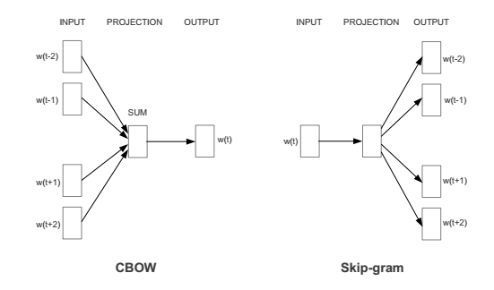
Word Embeddings: Word2Vec(tor) Continued.
Word2Vec Configurations
Word2vec has two models
Continuous Bag of Word (CBOW)
Predict a word w(t) given its context
Skip-gram models
Predict context words given a word w(t)
Associate Prof. Wei Liu & Tyler Bikaun, UWA

Slide 41
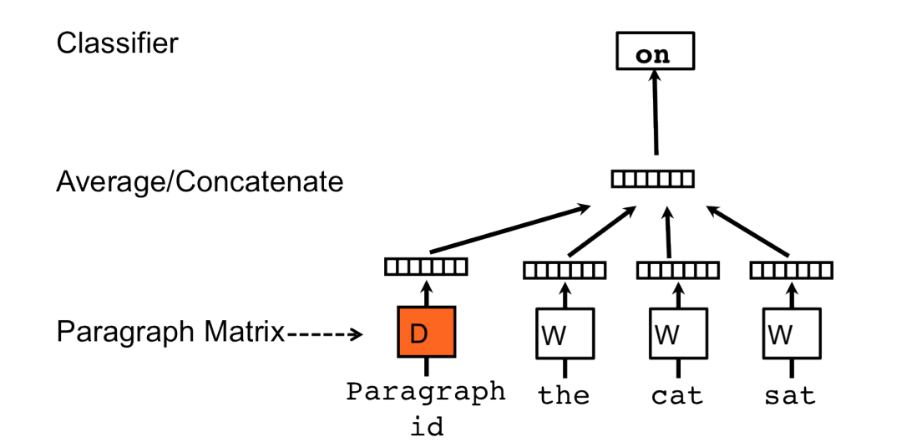
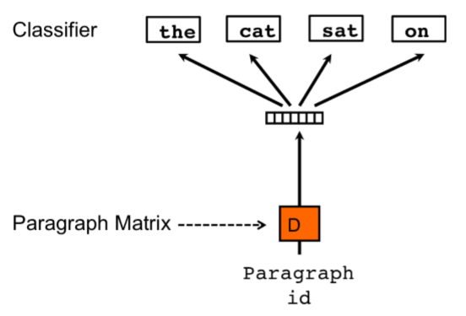
Other Language Representations
Document embedding
Different Embeddings Forms
Sentences - Sent2Vec
Paragraphs - Doc2Vec
Document topics - Top2Vec
Multi-Modal - Data2Vec
Associate Prof. Wei Liu & Tyler Bikaun, UWA
Notes:
Document embedding techniques: https://towardsdatascience.com/document-embedding-techniques-fed3e7a6a25d

Slide 42
Fundamentals of Natural Language Processing
Agenda (Hands-on Session) – Word Representations
Learning word representations from scratch
General domain and domain-specific word embeddings
Word similarity
Word vector clustering and visualisation
Supplementary Content
Interactive exploration of word2vec models: https://ronxin.github.io/wevi/
Associate Prof. Wei Liu & Tyler Bikaun, UWA Notebooks: 12.2.1 – Word vector visualization with Gensim & 12.2.2 – Learning Word Embeddings

Slide 43
12.3 Supervised Learning Learning from example

Slide 44
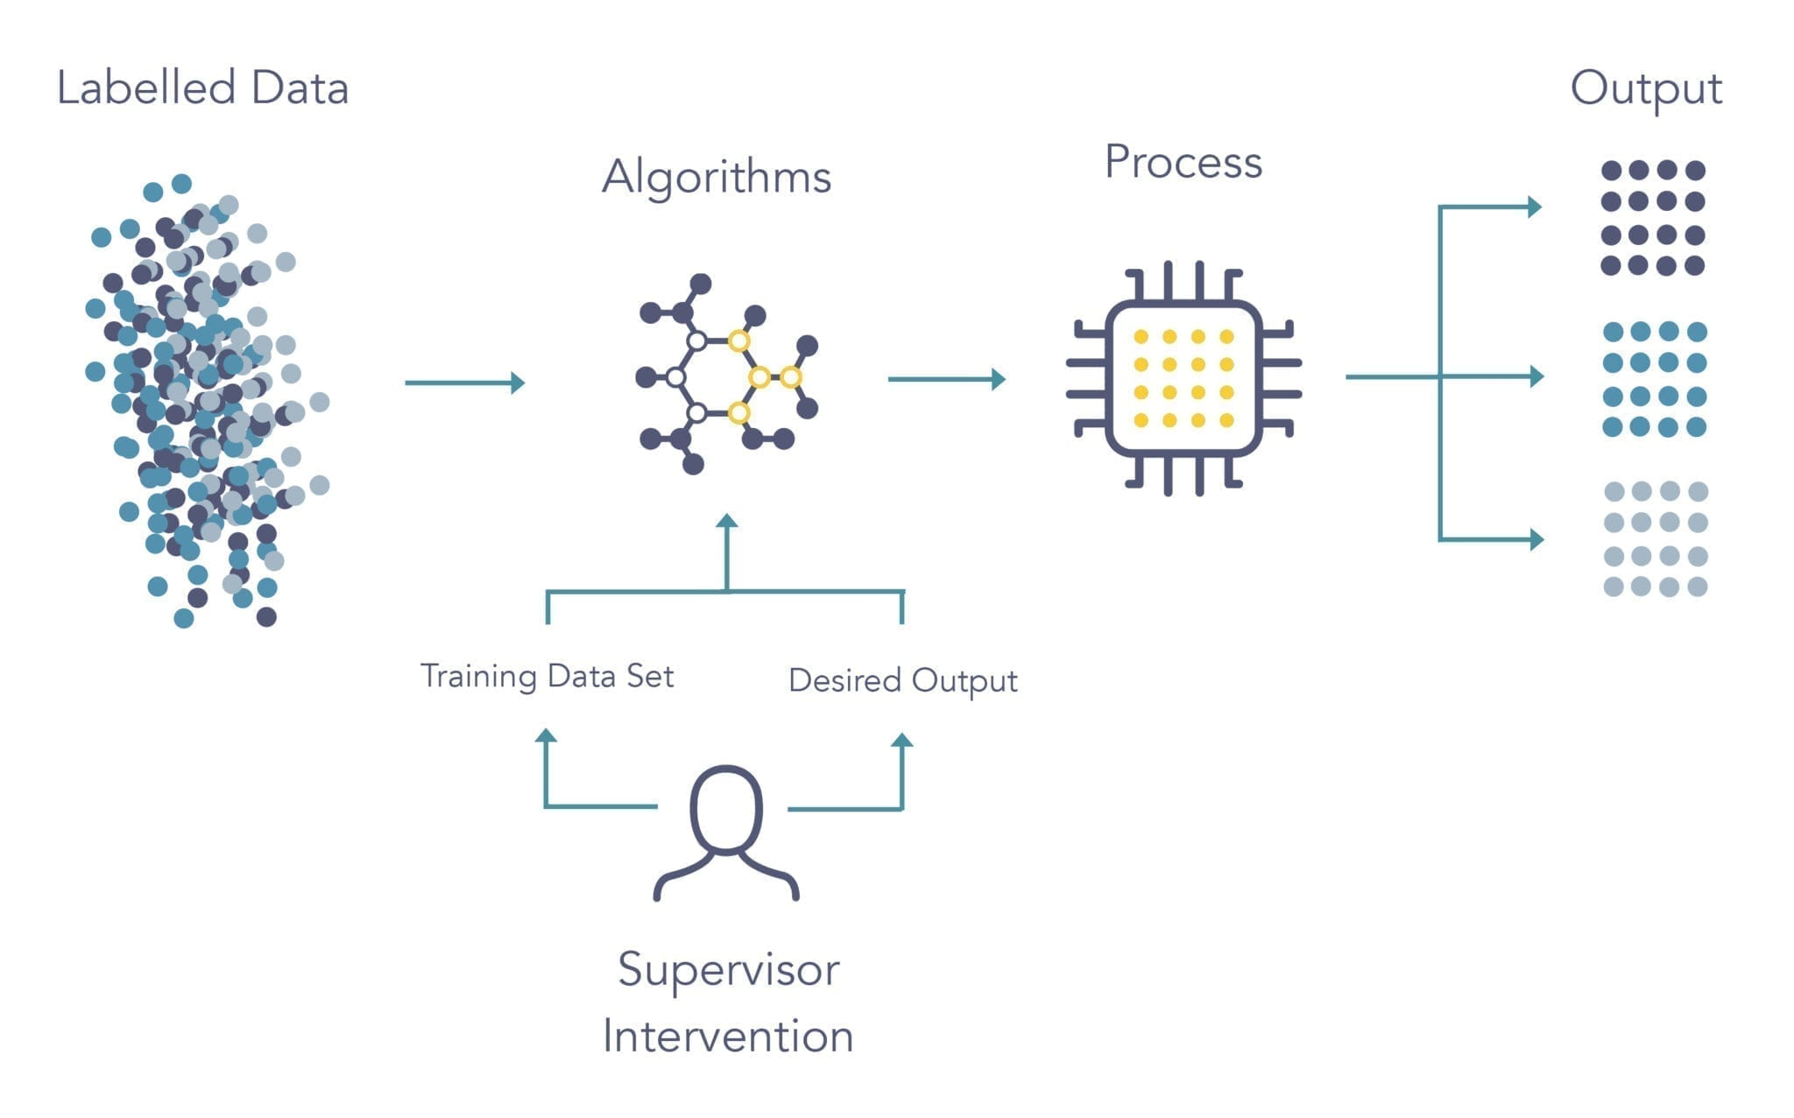
Supervised Learning
Fundamentals of Supervised Learning
Aim: Learn a complex function that maps X to y when provided a set of labelled x, y pairs as example
x,y pairs are typically acquired through human annotation using a pre-defined schema/model
Can vary in difficulty and complexity
Associate Prof. Wei Liu & Tyler Bikaun, UWA
Notes:
Ref: https://www.logpoint.com/da/blog/explained-siemply-machine-learning/

Slide 45
Supervised Learning
Agenda (Hands-on Session) – Exploring Supervised NLP Tasks using HuggingFace 🤗
Sequence Classification
Question Answering
Language Modelling
Text Generation
Named Entity Recognition
Summarization
Translation
Colab Notebook
Associate Prof. Wei Liu & Tyler Bikaun, UWA

Slide 46
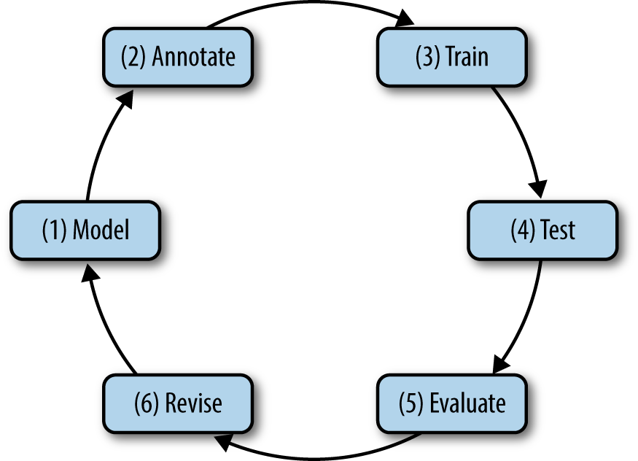
Fundamentals of Natural Language Annotation
The Annotation Development Cycle
Associate Prof. Wei Liu & Tyler Bikaun, UWA
Notes:
Natural Language Annotation for Machine Learning (Pustejovsky and Stubbs)

Slide 47
Annotation Example: Accident Report (NER)
1 - Specifying a Model for Annotation
What are the goals of the annotation task?
What are the characteristics of the dataset? Is it representative of the goals of the task? Is it balanced? What is the quality?
Does the task require subject matter experts or linguists?
Does a complete or partial model already exist?
walking in car park from office to workshop and rolled ankle
injury
activity
body part
Initial Model
Associate Prof. Wei Liu & Tyler Bikaun, UWA

Slide 48
Annotation Example: Accident Report (NER)
injury
activity
body part
2 - Performing human annotation
What tool will be used to perform annotation?
How many annotators are required to arrive at a gold standard?
What level of resources are committed to the annotation task?
How much data will be sufficient for training and testing?
activity
walking in car park from office to workshop and rolled ankle
injury
body part
Associate Prof. Wei Liu & Tyler Bikaun, UWA

Slide 49
Annotation Example: Accident Report (NER)
injury
activity
body part
3 & 4 - Training and Testing
What model architecture is best suited for the chosen task?
How will the texts be represented?
How will the model architecture be optimised?
What is the acceptable level of performance and expected bayes error rate?
activity
walking in car park from office to workshop and rolled ankle
injury
body part
Associate Prof. Wei Liu & Tyler Bikaun, UWA

Slide 50
Annotation Example: Accident Report (NER)
injury
activity
body part
5 – Evaluation of Model Performance
Does the model meet the acceptable level of performance?
What does the model do well at, what does the model struggle with?
activity
walking in car park from office to workshop and rolled ankle
injury
body part
Associate Prof. Wei Liu & Tyler Bikaun, UWA

Slide 51
Annotation Example: Accident Report (NER)
6 – Revising the Model
Does the model meet the goals of the task? If not, what modifications need to be made?
How are the annotators performing? Is the task too challenging?
walking in car park from office to workshop and rolled ankle
injury
activity
body part
location
New Model
Associate Prof. Wei Liu & Tyler Bikaun, UWA

Slide 52
Annotation Example: Accident Report (NER)
activity
location
location
location
walking in car park from office to workshop and rolled ankle
injury
body part
Associate Prof. Wei Liu & Tyler Bikaun, UWA

Slide 53
Annotation Example: Accident Report (ET)
location
location/car park
location location/office
location
location/workshop
walking in car park from office to workshop and rolled ankle
activity
activity/walking
injury injury/sprain
body part body part/leg
body part/leg/ankle
Associate Prof. Wei Liu & Tyler Bikaun, UWA

Slide 54
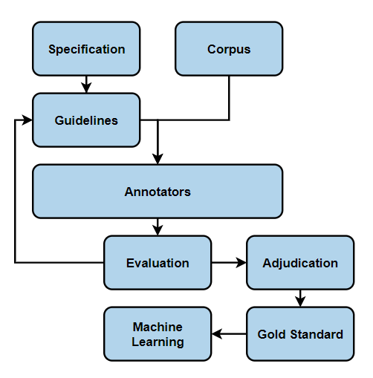
Fundamentals of Natural Language Annotation
After Development - The Annotation Cycle
Specification: model of phenomena for a specific task
Guidelines: helps annotators reliably label or tag the corpus
Annotators: recruited or crowd sourced humans
Evaluation: inter-annotator agreement
Adjudication: creating a gold-standard annotated corpus
Machine Learning: using annotations for supervised learning
Associate Prof. Wei Liu & Tyler Bikaun, UWA
Notes:
Natural Language Annotation for Machine Learning (Pustejovsky and Stubbs)

Slide 55
12.4 Unsupervised Learning Learning without example

Slide 56
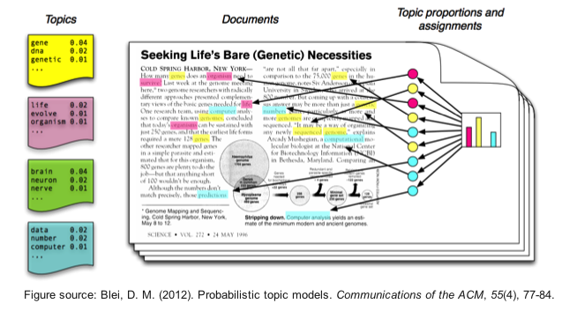
Unsupervised Learning: Topic Modelling
Suppose you have the following set of sentences:
I eat fish and vegetables.
Fish are pets.
My kitten eats fish.
Latent Dirichlet allocation (LDA) is an unsupervised topic modelling algorithm that automatically discovers topics that these documents contain.
bold words under the Topic F, which we might label as “food“
italics words might be classified under a separate Topic P, which we might label as “pets“
https://www.quora.com/What-is-the-best-way-to-explain-topic-modeling-to-a-layman
Associate Prof. Wei Liu & Tyler Bikaun, UWA

Slide 57
Unsupervised Learning: Topic Modelling
LDA defines each topic as a bag-of-words (bow), and you have to label the topics as you deem fit.
We can infer the content spread of each sentence by a word count
Sentence 1 (I eat fish and vegetables): 100% Topic F
Sentence 2 (Fish are pets): 100% Topic P
Sentence 3 (My kitten eats fish): 33% Topic P and 67% Topic F
We can derive the proportions that each word constitutes in given topics. For example, Topic F might comprise words in the following proportions: 40% eat, 40% fish, 20% vegetables, …
Associate Prof. Wei Liu & Tyler Bikaun, UWA

Slide 58
Unsupervised Learning: Topic Modelling
Three Steps
LDA defines each topic as a bag-of-words (bow), and you have to label the topics as you deem fit.
Specify how many latent topics are there
For each word, assign a temporary topic, according to a Dirichlet distribution, e.g. kitten -> F
If a word appears twice, each word may be assigned to different topics.
Function words (e.g. “the”, “and”, “my”) are removed and not assigned to any topics.
Topic assignment is updated based on two criteria:
How prevalent is that word across topics?
How prevalent are topics in the document?
Associate Prof. Wei Liu & Tyler Bikaun, UWA

Slide 59
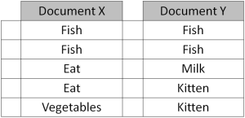
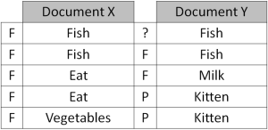
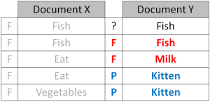
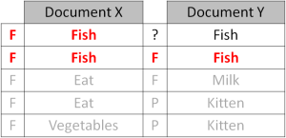
Unsupervised Learning: Topic Modelling
Repeated refinement
The process of checking topic assignment is repeated for each word in every document, cycling through the entire collection of documents multiple times.
This iterative updating is the key feature of LDA that generates a final solution with coherent topics.
Associate Prof. Wei Liu & Tyler Bikaun, UWA

Slide 60
Unsupervised Learning
Agenda (Hands-on Session) – Topic Modelling using Latent Dirichlet Allocation (LDA)
Corpus pre-processing including lemmatization
Training LDA model from scratch
Interactive visualisation of LDA model
Exploration of LDA features
Associate Prof. Wei Liu & Tyler Bikaun, UWA Notebook: 12.3 – Topic Modelling using LDA

Slide 62
Additional Content

Slide 63
NLP Pipelines – Ontology Learning from Text
Knowledge Representation
Machine Learning
Computational Linguistic
Graphs in knowledge representation
Two different sources
Knowledge experts (logic based)
Knowledge discovery (from natural language texts)
Ontology learning
Entity Extraction
Symbolic
Unsupervised learning
Supervised learning
Subsymbolic
Deep learning
Entity Relation Extraction
Associate Prof. Wei Liu, UWA

Slide 64
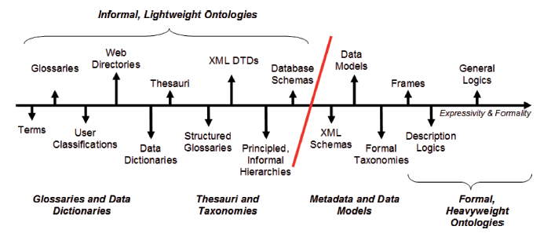

Lightweight Ontologies
Overview – What’s Light Weight Ontology
Wilson Wong, Wei Liu, and Mohammed Bennamoun. (2012) Ontology Learning from Text: A look back and into the future, ACM COMPUTING SURVEYS, 44, 4, Article 20, pp. 20:1-20:36
Associate Prof. Wei Liu, UWA

Slide 65
text > sets of corpora are prepared for ontology construction. Web Crawling is performed to gather web pages from general sources such as Reuters, Discovery and CNet to create the Contrastive Corpus. Readily available non-domain specific
Lightweight Ontologies
texts
term candidates
terms
Text Preprocessing
Text Processing
Term Recognition
Relation Acquisition
parse HTML/XML files for texts.
segment texts to identify sentences.
remove noise.
parse sentences for part-of-speech and grammatical information.
extract noun phrases as term candidates and measure their collocational strength (i.e. unithood).
determine the relevance of term candidates with respect to a domain (i.e. termhood) using text corpora.
acquire semantic relations between terms.
[University of WA]
[education]
[next year]
[Perth]
…
How is [University of WA] related to [education]
...University of WA… universities of Perth...
...[University of WA]…[universities] of [Perth]….
1

Slide 66
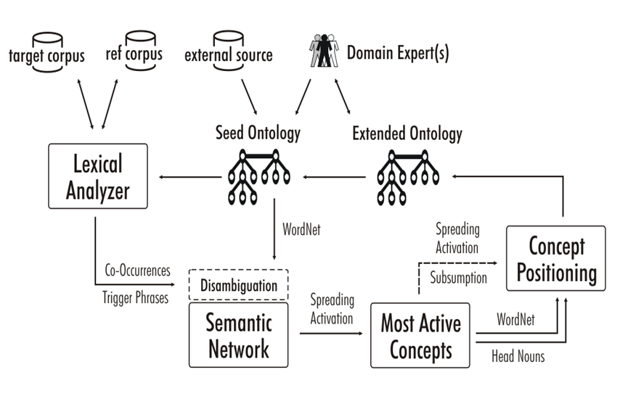
Ontology Learning from Text – System Overview
A semi-automatic ontology learning system
Wei Liu, Arno Scharl & Albert Weischselbraun, 2005
Associate Prof. Wei Liu, UWA

Slide 67
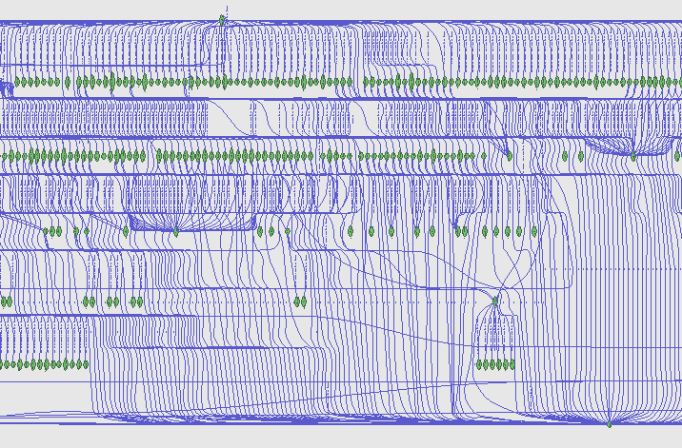
Ontology Learning from Text – Term Co-ocurrence
Semantic Network
Visualisation
Associate Prof. Wei Liu, UWA

Slide 68
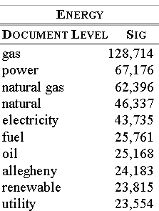
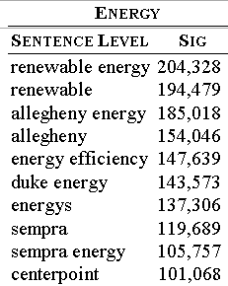
Ontology Learning from Text – Term Significance
Results of climate change data analysis
Associate Prof. Wei Liu, UWA

Slide 69
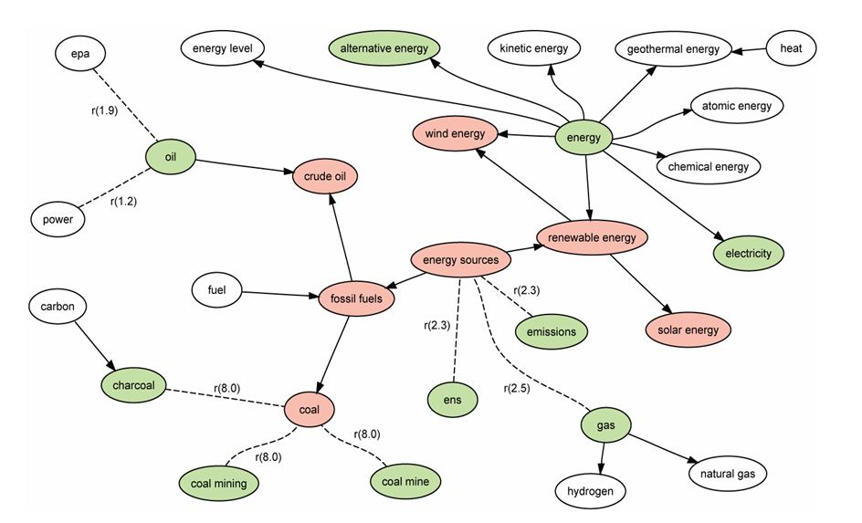
Ontology Learning from Text – Building Lightweight Ontologies
Spreading Activation
Associate Prof. Wei Liu, UWA

Slide 70
12.4 Neural Language Processing

Slide 71
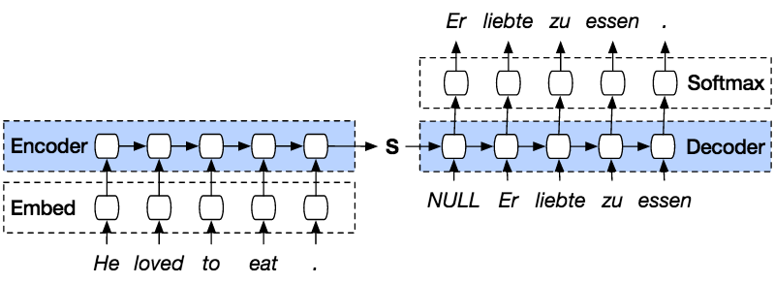
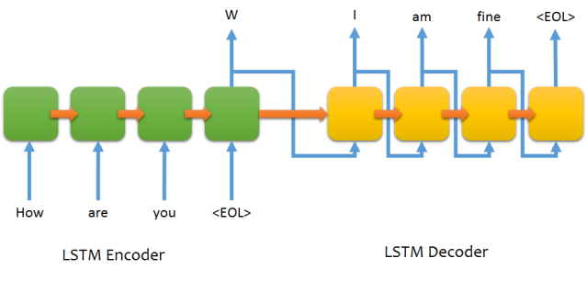

Sequence to Sequence Learning (Encode then Decode)
Associate Prof. Wei Liu, UWA

Slide 72

LSTM
Contains four interacting layers
Associate Prof. Wei Liu, UWA

Slide 73

LSTM
Inside a cell
Associate Prof. Wei Liu, UWA

Slide 74

LSTM – Forget gate
http://colah.github.io/posts/2015-08-Understanding-LSTMs/

Slide 75


LSTM – Input Gate Layer
$$b_{C})$$
Associate Prof. Wei Liu, UWA

Slide 76

LSTM - Update
Associate Prof. Wei Liu, UWA

Slide 77

LSTM – Output Gate
Associate Prof. Wei Liu, UWA

Slide 78
Sequence to Sequence Learning (Encode then Decode)
Associate Prof. Wei Liu, UWA

Slide 79


Associate Prof. Wei Liu
Educator
Program Chair of Data Science, Department of Computer Science and Software Engineering, The University of Western Australia
CORE Skills Data Science Springboard Delivery Team
Wei Liu is a teaching and research academic at UWA in the Department of Computer Science and Software Engineering focusing on knowledge discovery from natural language text. Her research focuses on knowledge discovery from natural language text, deep learning methods for knowledge graph construction and analysis, as well as sequential data mining and forecasting in traffic and water consumption domain.
Wei received her PhD from the University of Newcastle, Australia in 2003. She has published in highly reputable journals such as ACM Computer Surveys, Journal of Data Mining and Knowledge Discovery, Knowledge and Information Systems and presented at key international events including the International Conference on Data Engineering (ICDE) and ACM International Conference on Information and Knowledge Management (CIKM).
Wei has won three Australian Research Council Grants and managed several industry grants. Her current industry-related research projects include knowledge graph refinement for geological survey reports, incident log analysis and visualisation, short-term traffic predication and cognitive computing for asset management.
Program Delivery Day 12 (Special Data Types - Natural Language Processing & Text Mining)
Email: wei.liu@uwa.edu.au | Publications: https://research-repository.uwa.edu.au/en/persons/wei-liu

Slide 80

Tyler Bikaun
Educator
PhD Candidate (Technical Language Processing), Department of Computer Science and Software Engineering, The University of Western Australia & Mechanical Engineer
CORE Skills Data Science Springboard Delivery Team
Tyler Bikaun is a Mechanical Engineer turned PhD candidate at UWA and a scholar with the Mineral Research Institute of Western Australia and ARC Training Centre for Transforming Maintenance through Data Science. His research focuses on the intersection of computer science and industrial engineering, in particular, applying computational techniques to technical texts in the context of industrial maintenance.
Prior to commencing his PhD, Tyler worked in engineering consulting to the resources and utilities sectors in Western Australia. Here he was involved in asset performance optimisation of rotating equipment and advanced analytics for asset health monitoring applications.
Program Delivery Day 12 (Special Data Types - Natural Language Processing & Text Mining)
Email: tyler.bikaun@research.uwa.edu.au | LinkedIn: https://www.linkedin.com/in/tyler-bikaun

